Slide 1
Database Management system

Slide 2
DBMS
Software tool that helps organize, store and retrieve data from a database.
It involves a number of functions that collectively work together to ensure that the data is accurate, available and accessible.

Slide 3
Main elements of DBMS
A physical database that contains the data.
A database engine that helps to access the data and modify its contents.
A database scheme which provides the logical structure of the data stored in the database.

Slide 4
Advantage of DBMS
Reducing Data Redundancy.
Sharing of data.
Data Integrity
Data security
Privacy
Backup and Recovery
Data Consistency

Slide 5
ER(Entity-Relationship )-Model
ER model stands for an Entity-Relationship model.
It is a high-level data model.
Used to define the data elements and relationship for a specified system.
Develops a conceptual design that is
very simple and easy to design view of data.
In ER modeling, the database structure is portrayed as a diagram called an entity-relationship diagram.

Slide 6
Component of ER diagram
Entity
Attribute
Relation

Slide 7
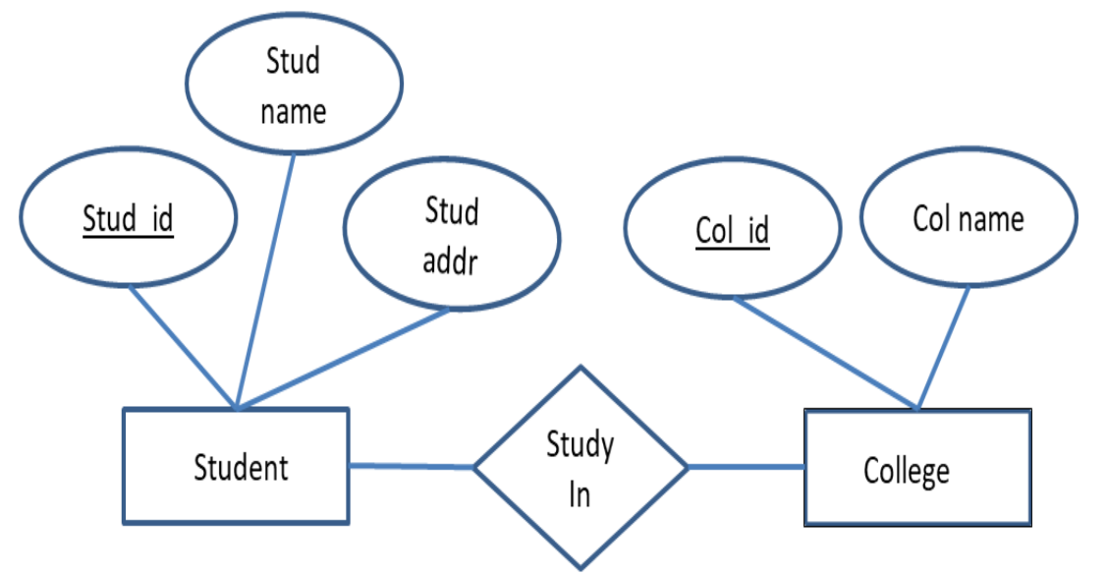

Slide 8
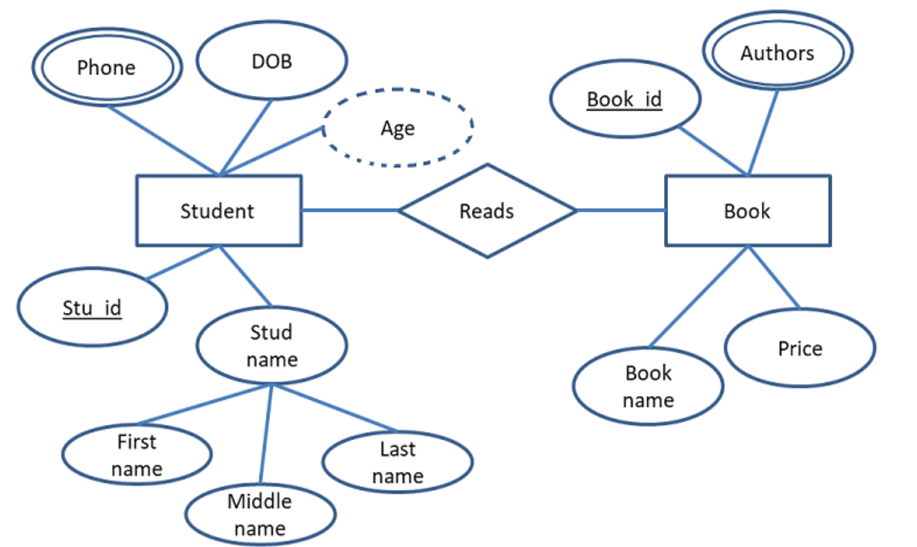

Slide 9
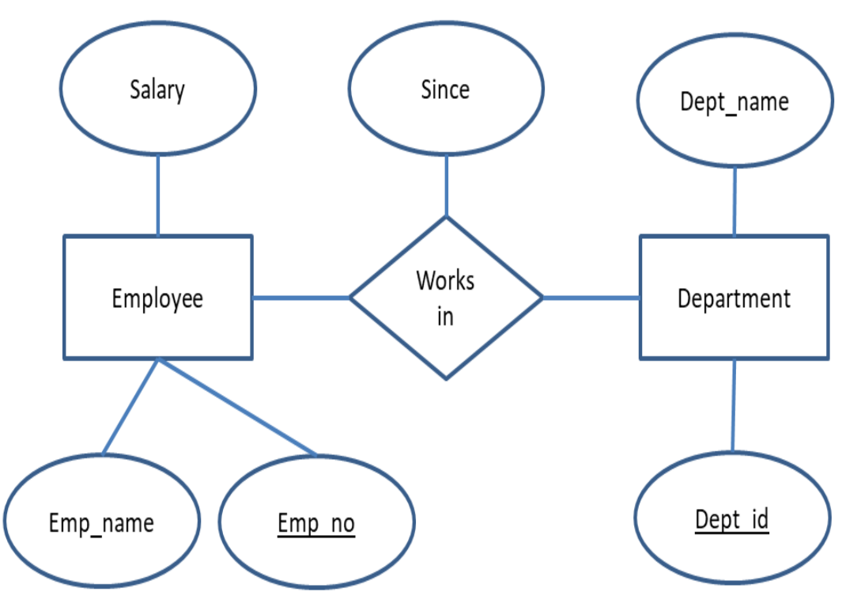

Slide 10
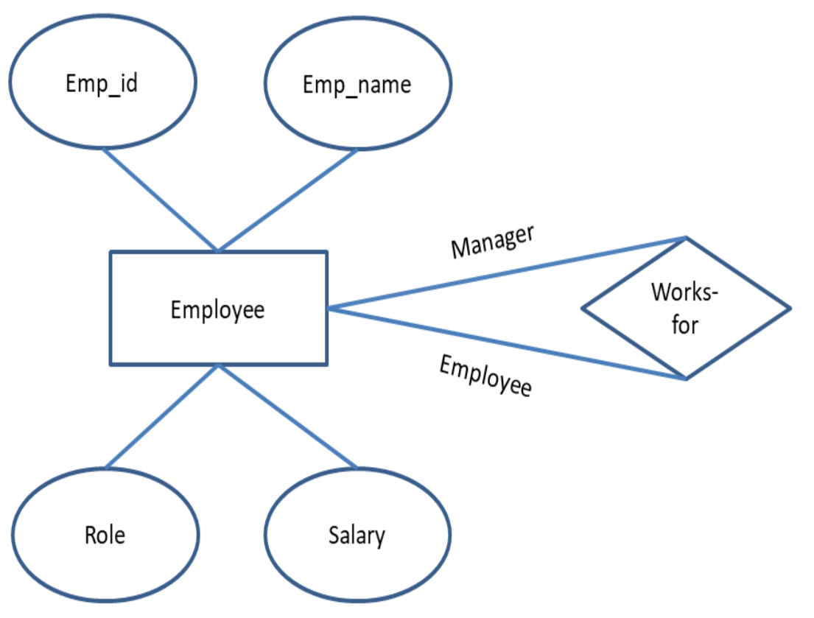

Slide 11
Entity
An entity is an object or component of data. It is a concept about which information is stored. Information are known as attributes and relationship.
Type:
Normal Entity
Weak Entity: An entity that cannot be uniquely identified by its own attributes and relies on the relationship with other entity is called weak entity. The weak entity is represented by a double rectangle.

Slide 12
Attribute
An attribute describes the property of an entity. An attribute is represented as Oval in an ER diagram.
Type:
1. Key attribute 2. Composite attribute 3. Multivalued attribute 4. Derived attribute

Slide 13
Type of Attributes
Key Attribute:
A key attribute can uniquely identify an entity from an entity set.
Composite Attribute:
An attribute that is a combination of other attributes is known as composite attribute. Like Address
Multi-Valued Attribute:
An attribute that can hold multiple values is known as multivalued attribute. It is represented with double ovals in an ER Diagram. Like phone-no
Derived attributes:
A derived attribute is one whose value is dynamic and derived from another attribute. It is represented by dashed oval in an ER Diagram. Like age.

Slide 14
Relationship
One to one
One to Many
Many to One
Many to Many

Slide 15
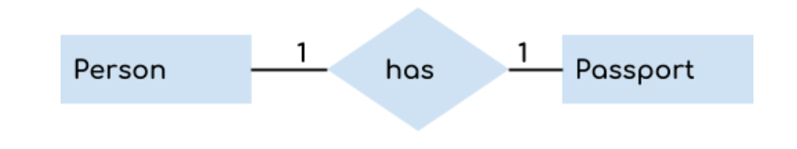

Slide 16
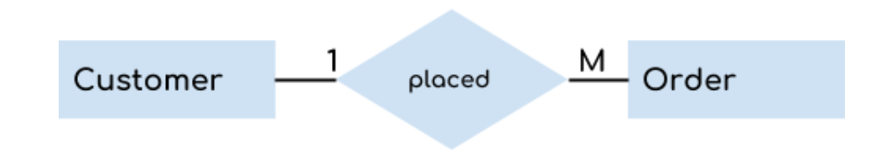

Slide 17


Slide 18
